Slide 1

NO
SMART
PHONE
ZONE

Slide 2
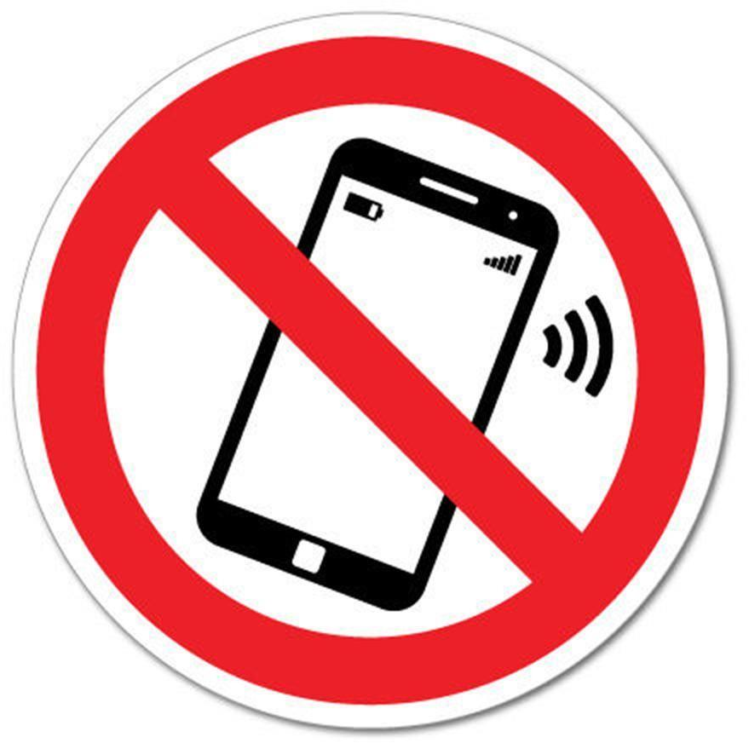
NO
SMART
PHONE
ZONE

